Slide 1

IBM Project Presentation on “Named Entity Recognition using Transformer Architecture”
By
Group ID: G13
Raj Kariya (21162101011)
Jhanvi Patel (22162122008)
Dushyant Vyas (22162172006)
Institute of Computer Technology, Ganpat University
Date: 18 Feb 2025

Slide 2
Table of Contents
Introduction
Objectives
Related Background
Expected Outcome
Tools & Technologies
Methodology (Modules)
BERT & NER Architecture
Flowchart
TimeLine
Implementation Details
Conclusion
References

Slide 3
Introduction
Named Entity Recognition (NER) is a crucial task in natural language processing (NLP) that involves identifying and classifying entities such as names, locations, organizations, dates, and more within unstructured text.
Human Resource (HR) departments often face the daunting task of evaluating vast numbers of resumes to shortlist candidates. Many resumes contain excessive and irrelevant information, making manual evaluation time-consuming and error-prone.
This project aims to address these challenges by building a transformer-based NER model that can accurately extract key information from resumes.

Slide 4
Objective
To develop a transformer-based NER model capable of accurately identifying key entities in resumes.
To design a user-friendly web interface using Django for uploading and processing resumes.
To store and manage extracted information effectively using MongoDB.
To simplify and accelerate the candidate shortlisting process for HR departments.
To ensure scalability and adaptability of the system for future enhancements.

Slide 5
Related Background
Named Entity Recognition (NER) is a subtask of natural language processing (NLP) that focuses on identifying and categorizing entities within text into predefined categories such as names of persons, organizations, locations, dates, percentages, and more.
NER plays a vital role in extracting structured information from unstructured text, enabling better analysis and decision-making across various domains.

Slide 6
Expected Outcome
This project focuses on creating a pipeline for automatic resume processing using NER :
Uploading resumes in various formats (e.g., PDF, DOCX).
Extracting essential information such as name, contact details, skills, qualifications, and work experience.
Displaying extracted data on a dashboard for easy evaluation.
Storing and retrieving data efficiently using MongoDB.
Providing APIs for integration with other HR tools or platforms.

Slide 7
Tools and Technologies
Frontend – Django, HTML, CSS, JavaScript
Backend – Fast API, Python
Database – MongoDB
NER Model Development – BERT, Python
Testing and Deployment – Docker and AWS

Slide 8
Methodology (Modules)
Step 1: Data Collection & Preprocessing, Cleaning text, handling missing values, tokenization.
Step 2: Model Selection & Fine-tuning BERT-based NER model training.
Step 3: Training & Hyperparameter Tuning, Learning rate optimization, batch size adjustments.
Step 4: Evaluation Precision, Recall, F1-score metrics.
Step 5: Deployment & Integration, Model API for easy use in real-world applications.

Slide 9
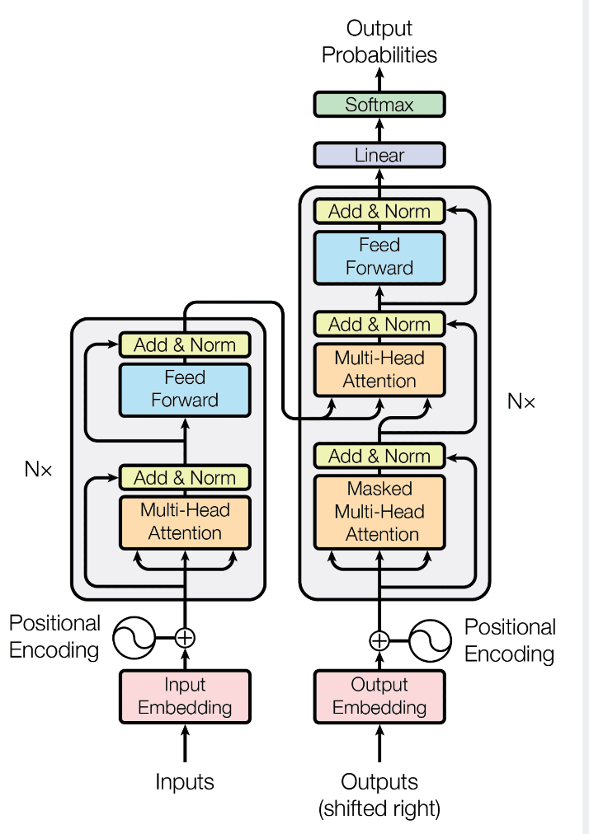
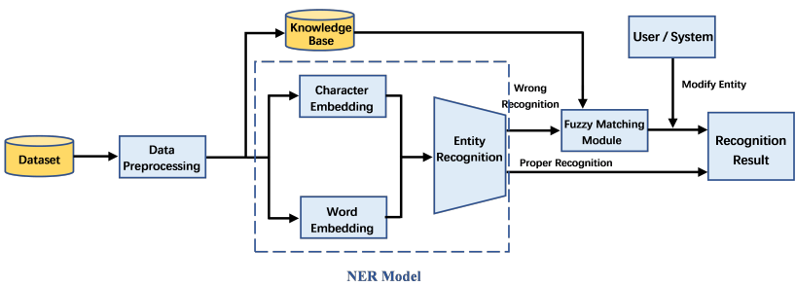
BERT & NER Architecture

Slide 10
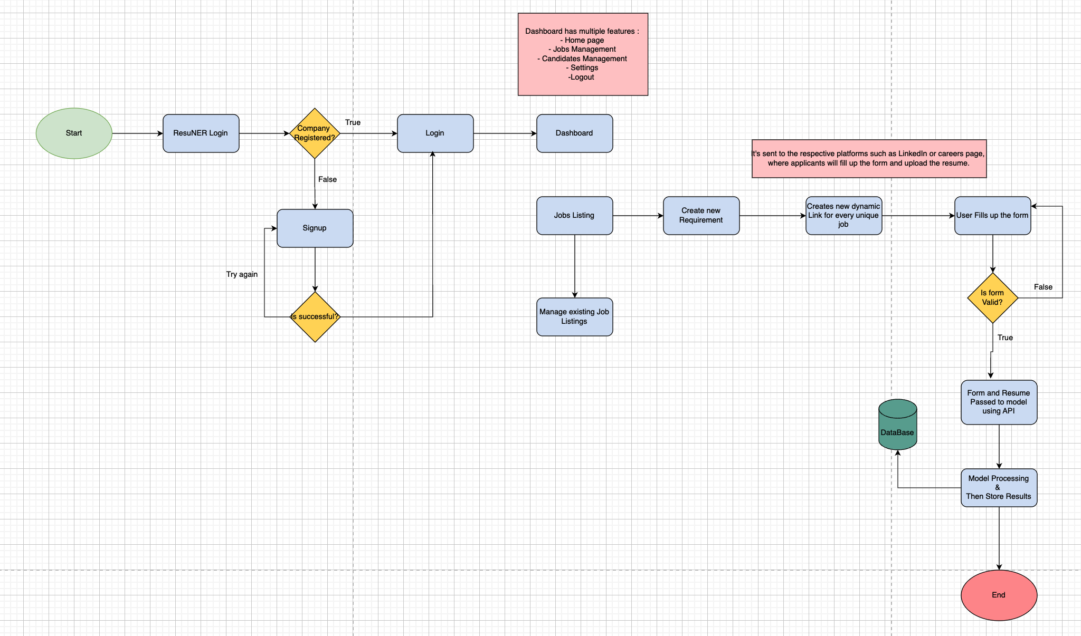
Flowchart

Slide 11
Timeline
Timeline Breakdown:
Month 1: Data Preprocessing & Annotation.
Month 2: Model Selection & Training.
Month 3: Performance Evaluation & Optimization.
Month 4: Final Testing & Deployment.
Progressive:
Frontend & Backend

Slide 12
Implementation Details
Frontend: Setting Django web-app and its various functionalities, like uploading resume, creating a dashboard, etc.
Backend: Implementing API endpoints using Django REST Framework (DRF) and integrating the NER model using python with the web-app.
NER Model: Loading the pre-trained model and fine-tuning it the given use-case through rigorous training.
Testing and Debugging: Testing the robustness of the system using various formats of resume. Also, optimizing the code for performance and accuracy with security measures integrated in it.
Deployment: Deploy on cloud and secure the deployment using security measures designed with OWASP’s Top 10 Vulnerabilities in focus.

Slide 13
Conclusion
The Named Entity Recognition (NER) system for resume evaluation demonstrates the potential of transformer-based models in automating a critical aspect of the recruitment process.
By leveraging advanced NLP techniques, the system effectively extracts relevant information from resumes, reducing manual effort and improving efficiency.
Future enhancements will further expand the system's capabilities, making it an indispensable tool for modern HR departments.

Slide 14
References
BERT Architecture
Resume NER Dataset
NER IBM
Tokenization Article

Slide 15
Thank You !!

